Slide 1
Aleksandar Milev
HR System Presentation

Slide 2
HR System Task
As an HR manager, I want to be able to manage the employees in my company
The hierarchy in the company includes the following roles:
• Trainee
• Junior
• Intermediate
• Senior
• Team leader
• Project manager
• Delivery director
• CEO

Slide 3
Requirements & User Stories
Each employee must have information about Name, his position, salary, workplace-City, email, phone, Project and his manager.
Trainee, Junior, Intermediate and Senior employees are part of team managed by a Team lead.
One project manager can manage multiple teams. Delivery director is on top of multiple project managers. CEO is the head of the entire company.
I must be able to add a new employee, see and edit the existing ones.
I need to be able to choose Trainee, Junior, Intermediate, Senior or Team lead and see in which team they belongs together with information who is their Lead, Project Manager, Delivery director, CEO.
I need to be able to move employees to different teams and delivery verticals.
Technologies to be included: ASP.NET MVC, EntityFramework, SQL Express

Slide 4
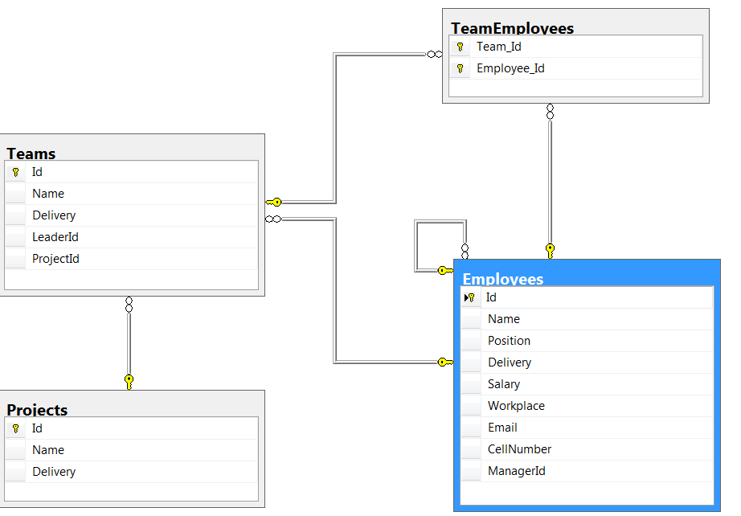
Models

Slide 5
Controllers
Employee Controller
Team Controller
Project Controller

Slide 6
Employee Controller
1. public ActionResult Index() -> GET Request
2. public ActionResult Details(int? id) - > GET Request
3. public ActionResult Create() => GET Reqest
4. public ActionResult Create([Bind(Include = "Id, Name,Position,Delivery,Salary,WorkPlace,Email,CellNumber,ManagerId")] Employee employeeModel) => POST Request
5. public ActionResult Edit(int? id) => GET Request
6. public ActionResult Edit([Bind(Include = "Id,Name,Delivery,Salary,Position,WorkPlace,Email,CellNumber,ManagerId")] Employee employeeModel) => POST Request
7. public ActionResult EmployeeTeamPreview(int id) => GET Request

Slide 7
Team Controller
1. public ActionResult Index() => GET Request
2. public ActionResult Create() => GET Request
3. public ActionResult Create([Bind(Include = "Id,Name,Delivery,LeaderId,ProjectId, Members")] TeamWithEmployeesViewModel teamModel) => POST Request
4. public ActionResult Edit(int id) => GET Request
5. public ActionResult Edit([Bind(Include = "Id,Name,Delivery,LeaderId, Leader,ProjectId, Members")] TeamWithEmployeesViewModel teamModel) => POST Request

Slide 8
Project Controller
1. public ActionResult Index() => GET Request
2. public ActionResult Details(int? id) => GET Request
3. public ActionResult Create() => GET Request
4. public ActionResult Create([Bind(Include = "Id,Name,Delivery, Teams, Description")]ProjectWithTeamsViewModel projectModel) => POST Request

Slide 9
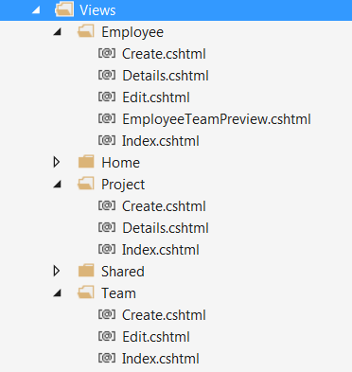
Views
Employee View’s
Team View’s
Project View’s

Slide 10
Thank you for your attention!

